Slide 2










Forward Multi-slice Modelling
3D multi-slice Sample
Reference LED (Origin)
$l^{th}$ LED
$$f_{i}^{(l,n)}(\vec{r})$$
Incident field
LED Matrix
Slice 1
$$g_{1}^{(l,n)}(\vec{r}) = O_{n,1}\left(\vec{r}\right)∙f_{i}^{(l,n)}(\vec{r})$$
Forward
$$f_{i}^{(l,n)}(\vec{r})$$
$$f_{2}^{(l,n)}(\vec{r}) = 𝓗_{δz}\left\{g_{1}^{(l,n)}(\vec{r})\right\}$$
h
Slice 2
$$δz$$
Optic axis
$n^{th}$subregion
m slices
$$z_{sample}$$
$$f_{sensor}^{(l,n)}\left(\vec{r}\right)=𝓗_{z_{sample} }\left\{g_{M}^{(l,n)}(\vec{r})\right\}$$
Sensor
Slice M
$g_{M}^{(l,n)}(\vec{r})$ $= O_{n,M}\left(\vec{r}\right)∙f_{M}^{(l,n)}(\vec{r})$
$$I_{n}^{(l)}\left(\vec{r}\right) = C_{σ}\left\{{\left|f_{sensor}^{(l,n)}\left(\vec{r}\right)\right|}^{2}\right\}$$

Slide 3
Reference LED (On axis)
Multi-angled illumination
LED Matrix
h
Sample
$$z_{sample}$$
Sensor

Slide 4
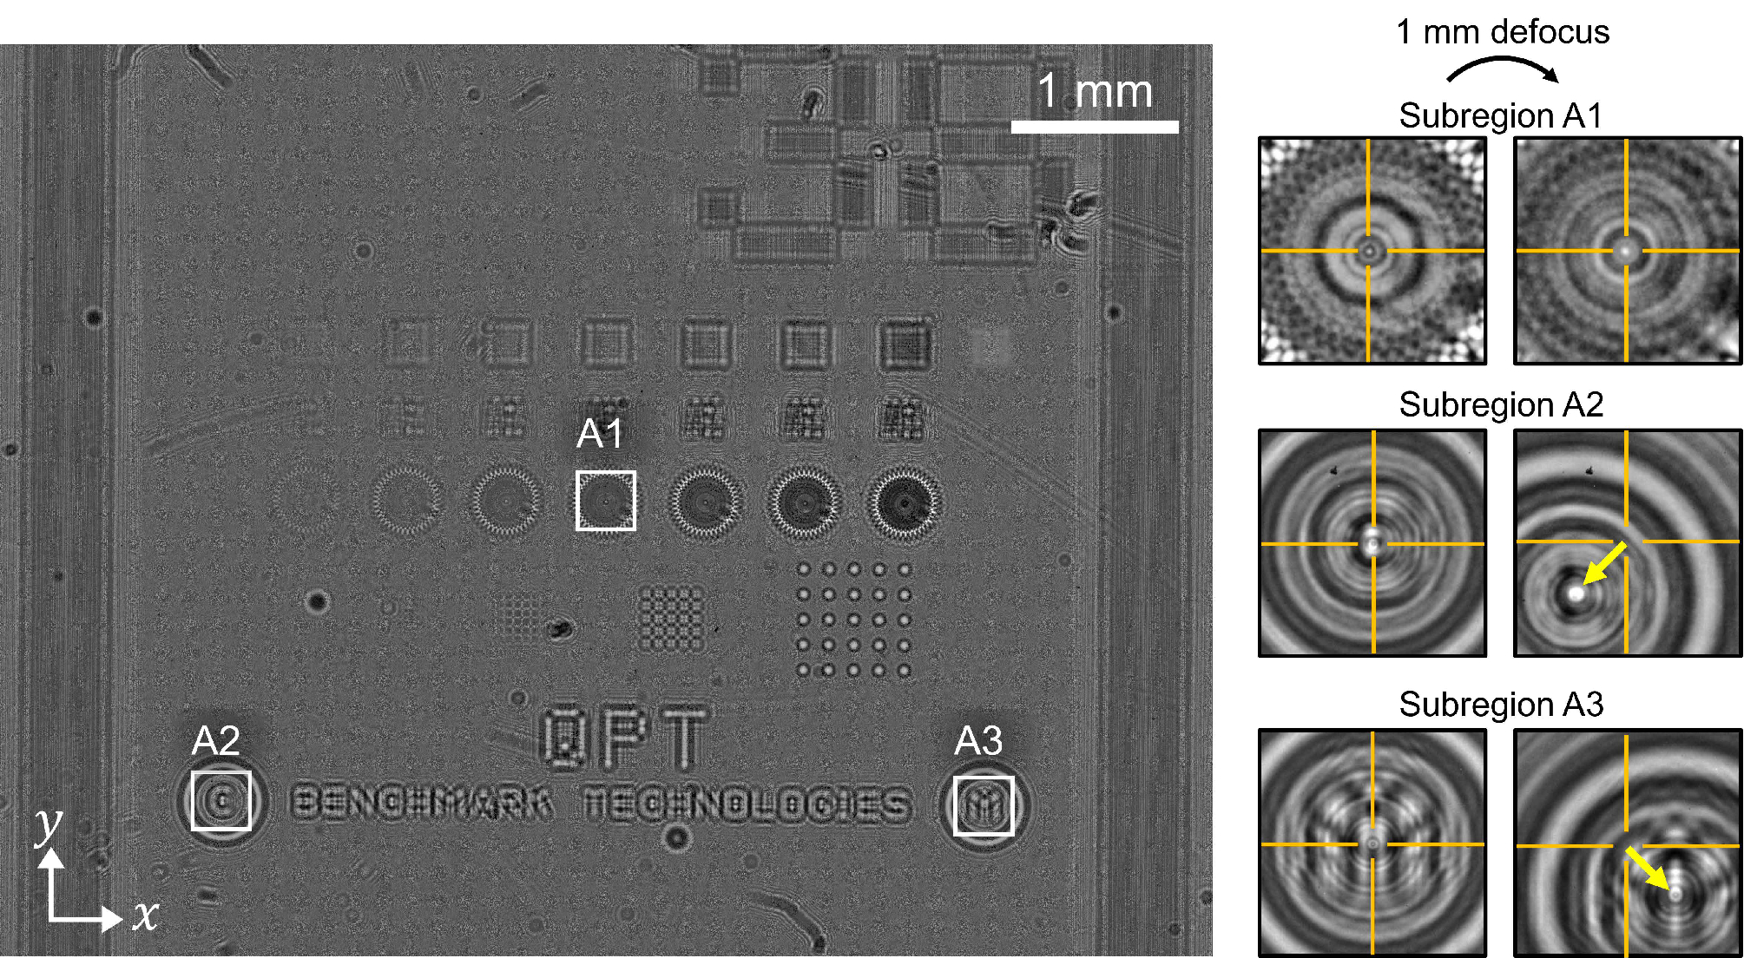
(a)
(b)

